Slide 1
I/O-Efficient Dynamic Searchable Encryption meets Forward & Backward Privacy
Priyanka Mondal
Ioannis Demertzis
Javad Ghareh Chamani
Dimitrios Papadopoulos
33rd USENIX Security Symposium
August 14th – 16th, 2024
Notes:
20 seconds

Slide 2
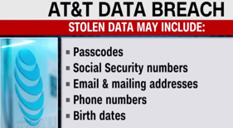
Motivation
Search/Update
Attacks!
Searchable Encryption (SE)
[Song et. al. SP 2000]
[Curtmola et. al. CCS 2006]
[Cash et. al. CRYPTO 2013] [Cash et. al. SP 2014]
[Chamani et. al. CCS 2018] [Demertzis et. al. NDSS 2020]
[Oya et. al. USENIX 2022] [Zhang et. al. USENIX 2023] […]
Encrypted Search
Privacy laws!
Notes:
45second :
0) lets motivate the problem a bit. So..
1)In today's digital world, users utilize various kinds of online services which require them to store their data on remote servers.
2)Unfortunately, we witnessed numerous data breaches in the past which exposed sensitive user information.
3)Moreover, service providers might exploit user data for their own profits
4)To address these, several privacy regulation laws have been established
5)One effective solution to protect the user data is to store it in encrypted form
6)But then the users loose the ability to perform queries e.g. search/update on their data
7) searchable encryption.is a technique that enables the users to query on the encrypted data.
10) This technique is also popularly known as encrypted search.
11) And it has been adapted in many real-world applications.
8) This was introduced by, Song et al. and it sparked extensive research in this field since then

Slide 3
Searchable Encryption (SE): How it works ?
F1
F2
Setup
Index
 | F1
 | F2
 | F1
 | F2
Notes:
3/4/5 reduce time, directly say DSE
Encrypted docs+ encrypted ind
20 Seconds
1) Now lets talk about how searchable encryption works
2) Say The client has lots of files with keywords, which they want to search later SO they create an encrypted map index.
Which maps each keyword to the file identifiers
4) The index along with the encrypted files are then uploaded to the server
(The client has documents with keywords, which they want to search later, they create an encrypted index out of those keywords
And upload it along with the encrypted files to the server )

Slide 4
Searchable Encryption (SE): How it works ?
F1
F1
Search
F2
Index
 | F1
 | F2
 | F1
 | F2
Notes:
During
15 seconds
1) later we can support encrypted searches
2) client sends an encrypted search token to the server
3) And The server returns the corresponding results

Slide 5
Dynamic Searchable Encryption (DSE)
F1
F1
Update
F2
F3
Index
 | F1
 | F2
 | F1
 | F2
 | F3
Notes:
15 seconds
In dynamic SE schemes client can also upload new files
and update the index accordingly
Similarly they can perform deletes as well.

Slide 6
This work!
* [Minaud et. al. CRYPTO 2022]
[Bost et. al. CCS 2016]
Dynamic Searchable Encryption (DSE)
Privacy
I/O-efficiency
Forward Privacy (FP)
Locality/Read-efficiency (for HDD)
Backward Privacy (BP)
Page-efficiency (for SSD)
Irreconcilable!
*
[...]
[Bost et al. CCS 2017]
[Chamani et al. CCS 2018]
[Demertzis et al. NDSS 2020]
[Chamani et al. USENIX 2022]
[...]
[Cash et. al NDSS 2014]
[Cash et. al. EUROCRYPT 2014]
[Asharov et al. STOC 2016]
[Demertzis et. al. SIGMOD 2017]
[Asharov et al. CRYPTO 2018]
[Demertzis et al. CRYPTO 2018]
[Bossuat et al. CRYPTO 2021]
FP and BP
I/O-efficient
[Minaud & Reichle CRYPTO 2022]
Our work
The first practical DSE schemes to achieve
Forward and Backward Privacy with I/O efficiency for HDD/SSD !
Notes:
1 minute
(so far 3min)
1)In this work we focus on two aspects of DSE schemes
2)privacy and IO-efficiency.
3)The two de-facto privacy guarantees need to be ensured for dynamic schemes are forward and backward privacy.
4) **whereas one of the most studied efficiency dimensions for SE schemes is IO efficiency.
SE schemes can be made more efficient by improving io efficiency metrices such as locality & read efficiency (when the data is stored on HDDs,) and by
Improving page efficiency (when the data is stored on SSDs.)
5)Many schemes have been proposed to achieve forward and backward privacy, while others have focused on I/O-efficient designs.
Most I/O-efficient schemes are static, except for the very last one in the list.
6)Previous research claimed that forward privacy and I/O-efficiency cant be achieved together
7)BUT Our work successfully bridges this gap.
8) We present the first practical implementation of Dynamic schemes that achieve forward - backward privacy with I/O efficiency for both HDDs and SSDs.

Slide 7
Forward Privacy (FP)
High-level idea: The server should not be able to relate an update with previous queries
F1
Time
Add
 | F1
1
Index
 | F1
2
Search
F2
 | F2
Add
 | F2
3
Server should not learn that update in timestamp 3 is for the same keyword
Notes:
35 seconds (faster → leakage free update)
What is Forward privacy ? It ensures that the server is not able to relate an update with previous queries
1)Lets say client performs an update at timestamp 1 for file F1 containing keyword cat
2) and then searches for “cat” at timestamp 2 which returns file F1
3) And then performs an update for file F2 again containing cat at TS 3
3) Now FP prevents revealing that the update at timestamp 3 is for the same keyword updated and searched at timestamps 1 and 2
. i.e. during an update no information about the updated content is revealed

Slide 8
Backward Privacy (BP)
High-level idea: The server should learn controlled information about deleted entries during search
F1
Time
Add
 | F1
1
Index
2
F2
 | F1
Add
 | F1
3
Del F2
Search
 | F2
4
TimeDB( ): files containing the keyword and when they were stored { (F1, 1) }
Updates( ): timestamp of each update for the keyword { 1, 2, 3 }
DelHist( ): exactly which deletion cancels which addition { (1, 3) }
Notes:
15 seconds
Now the highlevel idea of BP is that it
ensures the server learns only controlled information about the deleted entries during search
I will skip the details of backward privacy due to time contraint

Slide 9
Backward Privacy (BP)
High-level idea: The server should learn controlled information about deleted entries during search
F1
Time
Add
 | F1
1
Index
2
F2
 | F1
Add
 | F1
3
Del F2
Search
 | F2
4
Backward privacy I : TimeDB( )
Backward privacy II : TimeDB( ) and Updates( )
Backward privacy III : TimeDB( ), Updates( ) and DelHist( )
Notes:
Skipped

Slide 10
Locality/Read-efficiency
Locality: Number of non-contiguous memory locations accessed (number of disk-head jumps)
Read-efficiency: Number of memory locations read per result
Index
 | F1
 | F2
 | F1
 | F2
 | F2
 | F3
Search
Locality: 3
Read-efficiency: 1
Notes:
35 seconds
Now let’s move on to the definition of IO efficiency metrices Locality/Read efficiency for HDDs
Locality refers to the number random disk head jumps during an operation
While read-efficiency refers to the number of memory locations read per result. Lets see an example
1)Say the client wants to search for the keyword cat. Hence the disk head will have to perform three random jumps, to retrieve
corresponding entries, so locality is 3,
and because it reads only the locations pertaining to the result, read efficiency here is optimal

Slide 11
Locality/Read-efficiency
Locality: Number of non-contiguous memory locations accessed (number of disk-head jumps)
Read-efficiency: Number of memory locations read per result
Index
 | F1
 | F2
 | F1
 | F2
 | F2
 | F3
Search
Locality: 3
Read-efficiency: 1
Locality: 1
Read-efficiency: O(N)
O(1) Locality and O(1) Read Efficiency can not be achieved with O(Ν) space
[Cash & Tessaro Eurocrypt 2014]
Notes:
5 seconds
Whereas, a linear scan of the entire index will result into optimal locality, but worst case read efficiency.

Slide 12
Locality is not a friend of Forward Privacy
The server can infer these two entries are of same keyword
Index
 | F1
 | F2
 | F1
 | F3
Update
 | F2
Violates Forward Privacy
Notes:
25 seconds
For DSE schemes Storing new keyword entries adjacent to the existing entries for same keywords like shown in the picture will improve locality
But that will reveal to the server that these two entries are related, and hence this violates forward privacy

Slide 13
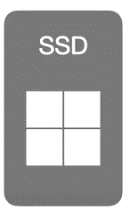
Page-efficiency
Page-efficiency: Ratio of number of pages retrieved for encrypted result to plaintext result
( , F3)
( , F1)
Page efficiency: 2
( , F1)
Each page can contain up to 2 entries
Notes:
15 seconds (different metric proposed)
Let’s briefly see what page-efficiency for SSDs means
It is the ratio of number of pages retrieved for encrypted results to the number of pages that
would be retrieved if the results were stored in plaintext
In here to fetch entries corresponding to keyword “cat”,
two pages need to be fetched, so page-efficiency is 2,

Slide 14
Page-efficiency
Page-efficiency: Ratio of number of pages retrieved for encrypted result to plaintext result
( , F1)
( , F3)
Page efficiency: 2
Violates Forward Privacy
Best case Page efficiency: 1
( , F1)
Each page can contain up to 2 entries
Notes:
10 seconds
We achieve better page efficiency by storing same keyword entries in same page
But that violates forward privacy, similar to the earlier HDD scenario.

Slide 15
This work!
* [Minaud et. al. CRYPTO 2022]
[Bost et. al. CCS 2016]
Dynamic Searchable Encryption (DSE)
Privacy
I/O-efficiency
Forward Privacy (FP)
Locality/Read-efficiency (for HDD)
Backward Privacy (BP)
Page-efficiency (for SSD)
Irreconcilable!
*
Search time
1128X faster on HDD
310X faster on SSD
2.5X faster on RAM
Update time
179X faster on HDD
4X faster on RAM
[...]
[Bost et al. CCS 2017]
[Chamani et al. CCS 2018]
[Demertzis et al. NDSS 2020]
[Chamani et al. USENIX 2022]
[...]
[Cash et. al NDSS 2014]
[Cash et. al. EUROCRYPT 2014]
[Asharov et al. STOC 2016]
[Demertzis et. al. SIGMOD 2017]
[Asharov et al. CRYPTO 2018]
[Demertzis et al. CRYPTO 2018]
[Bossuat et al. CRYPTO 2021]
FP and BP
I/O-efficient
Two families of DSE (FP+BP+I/O-efficienct)
vs
SoTA (FP+BP, non I/O-efficient)
[Minaud & Reichle CRYPTO 2022]
Our work
The first practical DSE schemes to achieve
Forward and Backward Privacy with I/O efficiency for HDD/SSD !
Notes:
30 seconds (so far 5 min 40 seconds)
1)So, we have reviewed these definitions and understood why
2) FP and I/O efficiency were seen as incompatible
Now we are ready to see the details of our schemes
We present two families of Io efficient DSE schemes that are asymptotically and experimentally better than sota non io-efficient DSE schemes
(Infact Experiments show searches in our schemes can perform up to 1000 and 300 times better on HDDS and SSDs respectively.
And, due to better assymptotics our schemes also perform better in memory)
----------------------------------------Numbers-------------------------------------------------------
Search 2^23 entries
14a → HDD
14e → SSD
12d → RAM
Update 5M entries
HDD → 11a
RAM → 11b
and our experiments take into account several settings
(for searching 1M results in a DB of size 2^23 compared to the state-of-the-art DSE schemes.)
4) Our schemes also achieve up to 120 and 2.5 times faster update time on HDD on RAM respectively for a DB of size 5M wrt no-io efficient sota dse schemes.

Slide 16
SDa : Static to Dynamic Compiler with FP+BP
Client always creates index₀ for a new update
[Demertzis et. al. NDSS 2020]
High-level idea:
Index₀
 | F1
Index₀
 | F2
Notes:
16-21 : 1 min 10 seconds
Our starting point was the SDa framework published in NDSS 2020 which
converts any static SE scheme into a dynamic one while maintaining forward & backward privacy (BP).
The high level idea In the SDa framework is
during an update, the client creates an index of size 1 using a static SE scheme and uploads it to the server. When two indexes of the same size exist, they are downloaded , decrypted, and merged into a single index of double the size and (uploaded back)

Slide 17
SDa : Static to Dynamic Compiler with FP+BP
Client always creates index₀ for a new update
Whenever two indices of same size exist, they are merged
[Demertzis et. al. NDSS 2020]
High-level idea:
Index₀
 | F1
Index₀
 | F2
Notes:
16-21 : 1 min 10 seconds
Our starting point was the SDa framework introduced by Demertzis et al. This framework functions as a static-to-dynamic compiler, meaning it converts a static searchable encryption (SE) scheme into a dynamic one while maintaining forward privacy (FP) and backward privacy (BP).
In the SDa framework, during an update, the client creates an index of size 1 using a static SE scheme and uploads it to the server. When two indexes of the same size exist, they are downloaded and merged into a single index of double the size.

Slide 18
SDa : Static to Dynamic Compiler with FP+BP
Client always creates index₀ for a new update
Whenever two indices of same size exist, they are merged
[Demertzis et. al. NDSS 2020]
High-level idea:
Index₀
 | F1
Index₀
 | F2
Notes:
16-21 : 1 min 10 seconds
And uploaded back to the server

Slide 19
SDa : Static to Dynamic Compiler with FP+BP
Client always creates index₀ for a new update
Whenever two indices of same size exist, they are merged
Up to O(log₂N) independent encrypted indices from N updates
Size of the i^{th} index is 2^{i}
[Demertzis et. al. NDSS 2020]
High-level idea:
Index₂
 | F4
 | F2
 | F3
 | F2
… up to
O(logN )levels
Index₁
 | F1
 | F2
Index₀
 | F3
2⁰
2¹
2²
Notes:
16-21 : 1 min 10 seconds
In this way SDa creates upto logN indices with N updates

Slide 20
SDa + Static IO-efficient SE schemes
[Cash et. al NDSS 2014]
[Cash et. al. EUROCRYPT 2014]
[Asharov et al. STOC 2016]
[Demertzis et. al. SIGMOD 2017]
[Asharov et al. CRYPTO 2018]
[Demertzis et al. CRYPTO 2018]
[Bossuat et al. CRYPTO 2021]
Static I/O-efficient SE
= DSE with
I/O-efficiency &
FP+BP
SDa +
Notes:
16-21 : 1 min 10 seconds
Since SDa transforms any static SE scheme into a dynamic one with FP and BP, ,if we can instantiate it with any static I/O-efficient SE scheme
we achieve IO efficienct DSE with FP+BP

Slide 21
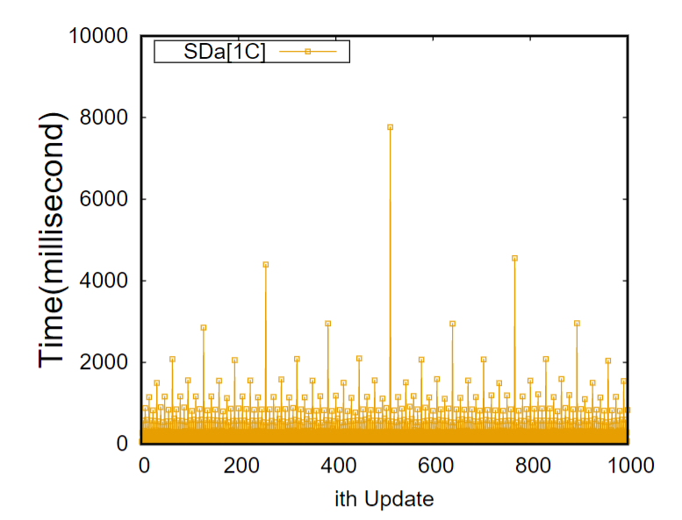
SDa has amortized Update cost
N/2
N/4
N/4
Notes:
16-21 : 1 min 10 seconds
But updates of SDa are amortized. Meaning Some updates are very efficient and some updates are really costly due to the merges of the indexes that happen at the client

Slide 22
How to de-amortize the update cost ?
[Cash et. al NDSS 2014]
[Cash et. al. EUROCRYPT 2014]
[Asharov et al. STOC 2016]
[Demertzis et. al. SIGMOD 2017]
[Asharov et al. CRYPTO 2018]
[Demertzis et al. CRYPTO 2018]
[Bossuat et al. CRYPTO 2021]
Static I/O-efficient SE
= DSE with
I/O-efficiency &
FP+BP,
but with amortized updates
SDa +
[Demertzis et. al. NDSS 2020]
SDd : Static to dynamic compiler with de-amortized update cost
Does NOT work
Violates Forward Privacy
Notes:
To solve this issue we went back to the same paper that presents another static to dynamic compiler framework: SDd
This framework again converts a static SE to a dynamic one, but with de-amortized update cost
But instantiating SDd with io efficient static schemes does not serve our purpose as it results in violation of FP
To understand how, first lets see how SDd works in highlevel

Slide 23
SDd : de-amortized SDa
[Demertzis et. al. NDSS 2020]
High-level idea:
Four indexes per level instead of one: NEW, OLD, OLDER, OLDEST
OLDEST₀
OLDEST₁
OLDEST₂
OLDER₀
OLDER₁
OLDER₂
… up to
logN-1 levels
OLD₀
OLD₁
OLD₂
NEW₀
NEW₁
NEW₂
2⁰
2¹
2²
Notes:
Slides 24 to 30 : 2 minutes (very highlevel)
In SDd instead of one there are four indexes namely NEW OLD OLDER and OLDEST in each index level

Slide 24
SDd : de-amortized SDa
[Demertzis et. al. NDSS 2020]
High-level idea:
Four indexes per level instead of one: NEW, OLD, OLDER, OLDEST
Update happens at NEW₀
When NEW_{i} is full it is moved to empty old index
OLDEST₀
OLDEST₁
OLDEST₂
OLDER₀
OLDER₁
OLDER₂
… up to
logN-1 levels
OLD₀
OLD₁
OLD₂
NEW₀
NEW₁
NEW₂
( , F1)
2⁰
2¹
2²
Notes:
1) The updates always happen at NEW0
2) Whenever NEW of any index level is full its entries are moved to one of the free old indexes

Slide 25
SDd : de-amortized SDa
[Demertzis et. al. NDSS 2020]
High-level idea:
Four indexes per level instead of one: NEW, OLD, OLDER, OLDEST
Update happens at NEW₀
When NEW_{i} is full it is moved to empty old index
OLDEST₀
OLDEST₁
OLDEST₂
( , F1)
OLDER₀
OLDER₁
OLDER₂
… up to
logN-1 levels
OLD₀
OLD₁
OLD₂
NEW₀
NEW₁
NEW₂
( , F1)
2⁰
2¹
2²
Notes:
2)

Slide 26
SDd : de-amortized SDa
[Demertzis et. al. NDSS 2020]
High-level idea:
Four indexes per level instead of one: NEW, OLD, OLDER, OLDEST
Update happens at NEW₀
When NEW_{i} is full it is moved to empty old index
OLDEST_{i} and OLDER_{i} are merged to create NEW_{i+1}
OLDEST₀
OLDEST₁
OLDEST₂
( , F1)
OLDER₀
OLDER₁
OLDER₂
( , F1)
… up to
logN-1 levels
OLD₀
OLD₁
OLD₂
NEW₀
NEW₁
NEW₂
OMAP₀
OMAP₁
2⁰
2¹
2²
Notes:
(now the placement matters )
And whenever older and oldest of an index levels are full they are merged and moved to the NEW index of next level.
So Everything again boils down to merging two indexes of same size say 2i and creating an index of double the size 2^i+1
2) The original SDd used an oblivious data structure: i.e. oblivious maps to store some meta data (like the keyword frequency) to figure out the placements
of the entries in the NEW index
(The high level idea is that during every update some amount of work will be done at every index level to make room for future updates, so that every update costs the same amount of time unlike SDa framework)
In this way during an update some amount of work is done in every index level, making the cost of every update almost same unlike Sda

Slide 27
SDd is NOT locality friendly
[Cash et. al NDSS 2014]
[Cash et. al. EUROCRYPT 2014]
[Asharov et al. STOC 2016]
[Demertzis et. al. SIGMOD 2017]
[Asharov et al. CRYPTO 2018]
[Demertzis et al. CRYPTO 2018]
[Bossuat et al. CRYPTO 2021]
Static I/O-efficient SE
One-choice Allocation (1C)
SDd +
[Demertzis et. al. NDSS 2020]
SDd : Static to dynamic compiler with de-amortized update cost
Does NOT work
Violates Forward Privacy
Notes:
10 seconds
Now let us choose 1C allocation from the list of static IO efficient schemes to analyze how SDd with1C violates FP
(Analyze, examine, investigate,)

Slide 28
One-Choice Allocation (1C)
[Asharov et al. STOC 2016]
Database is an array of bins
Entries for same keyword stored in adjacent bins
Adjacent bins are read with locality 1, during search
Bins are filled with dummy entries, if not full (gray entries)
High-level idea:
binSize = 3logNloglogN
( , F3)
( , F1)
( , F1)
( , F1)
( , F2)
( , F2)
#bins = N / logNloglogN
Locality | Read-efficiency | Space
O(1) | O(logNloglogN) | O(N)
Notes:
35 seconds
Now
In 1C the database is visualized as an array of bins
same keyword entries are stored in adjacent bins
3) to achieve optimal locality during search
4) if bins are not full, dummy entries are added, which is denoted by the gray circles here
2) For simplicity lets just omit the file identifiers from the bin entries from now onwards

Slide 29
SDd[1C] violates Forward Privacy
OLDEST_{i}
NEW_{i+1}
OMAP_{i}
OLDER_{i}
Server learns two entries are of same keyword
Violates Forward privacy
Notes:
In 1C scheme (like any other IO efficient schemes) placement of the entries is a direct function of their values,
So if we place the entries from older+oldest directly to the bins of NEW then
as soon the second cat keyword is placed in the third bin,
the server learns that it must be related to the entry already stored in the second bin, violating FP
Placement becomes a function of the keyword value , (now the placement matters )

Slide 30
SDd : de-amortized SDa
[Demertzis et. al. NDSS 2020]
High-level idea:
Four indexes per level instead of one: NEW, OLD, OLDER, OLDEST
Update happens at NEW₀
When NEW_{i} is full it is moved to empty old index
OLDEST_{i} and OLDER_{i} are merged to create NEW_{i+1}
OLDEST₀
OLDEST₁
OLDEST₂
OLDER₀
OLDER₁
OLDER₂
… up to
logN-1 levels
OLD₀
OLD₁
OLD₂
NEW₀
NEW₁
NEW₂
OMAP₀
OMAP₁
O(log³N)
Notes:
To solve this, we replace omaps with

Slide 31
L-SDd : Locality-aware de-amortized SDa
High-level idea:
Four indexes per level instead of one: NEW, OLD, OLDER, OLDEST
Update happens at NEW₀
When NEW_{i} is full it is moved to empty old index
OLDEST_{i} and OLDER_{i} are merged to create NEW_{i+1}
OLDEST₀
OLDEST₁
OLDEST₂
OLDER₀
OLDER₁
OLDER₂
… up to
logN-1 levels
OLD₀
OLD₁
OLD₂
NEW₀
NEW₁
NEW₂
Oblivious
merge₀
Oblivious
merge₁
O(log²N)
Notes:
Slides 24-30 : 2 minutes
with a novel asymptotically better performing protocol called oblivious merge to achieve our I/O efficient framework called L-SDd

Slide 32
L-SDd : Locality-aware de-amortized SDa
OLDEST_{i}
NEW_{i+1}
Oblivious
merge_{i}
OLDER_{i}
Bin capacity of level i+1 is 3
Notes:
This protocol merges two equal sized index preserving the locality of the entries
(10mins → need to make 9)

Slide 33
L-SDd : Oblivious-merge
OLDEST_{i}
NEW_{i+1}
Oblivious
merge_{i}
OLDER_{i}
Bin capacity of level i+1 is 3
Step 1 : Copy to buffer
BUFFER_{i}
Notes:
Slides 31-38 : 1 min 30 seconds
Now let us see the steps of oblivious merge at a high level
First, Elements of OLDER and OLDEST are copied into a buffer

Slide 34
L-SDd : Oblivious-merge
OLDEST_{i}
Step1 : Copy to buffer
Step 2 : Oblivious sort, assign bin tag, add dummy
2 3 1 2 3 1 2 ∞
1 1 1 2 2 2 3 3 3
OLDER_{i}
Bin capacity of level i+1 is 3
Notes:
1) They are then obliviously sorted based on the lexicographic order of the keywords.
2) Then each element is assigned a destination bin tag,
3) Dummy entries are added for each bin, up to their max capacity, which is 3 here, to hide the number of real & dummy entries

Slide 35
L-SDd : Oblivious-merge
OLDEST_{i}
Step 1 : Copy to buffer
Step 2 : Oblivious sort, assign bin tag, add dummy
2 3 1 2 3 1 2 ∞
1 1 1 2 2 2 3 3 3
OLDER_{i}
Step 3 : Oblivious sort
1 1 1 1 1 2 2 2
2 2 2 3 3 3 3 3 ∞
Bin capacity of level i+1 is 3
Notes:
1)The buffer is then obliviously sorted again, with respect to the bin tags,
2) grouping all entries with the same bin tag together.
Since each bin is assigned more than 3 entries, a linear scan is performed to tag the entries to be discarded as dummies
Since more elements are assigned to each bin than it can hold, a linear scan is performed to mark the entries that we want to discard as dummies.

Slide 36
L-SDd : Oblivious-merge
OLDEST_{i}
Step 1 : Copy to buffer
Step 2 : Oblivious sort, assign bin tag, add dummy
OLDER_{i}
Step 3 : Oblivious sort
Step 4 : Linear scan, add tag
1 1 1 ∞ ∞ 2 2 2
∞ ∞ ∞ 3 3 3 ∞ ∞ ∞
Bin capacity of level i+1 is 3
Notes:
The tags are shown as red infinity symbol

Slide 37
L-SDd : Oblivious-merge
OLDEST_{i}
Step 1 : Copy to buffer
Step 2 : Oblivious sort, assign bin tag, add dummy
OLDER_{i}
Step 3 : Oblivious sort
Step 4 : Linear scan, add tag
1 1 1 ∞ ∞ 2 2 2
∞ ∞ ∞ 3 3 3 ∞ ∞ ∞
Bin capacity of level i+1 is 3
Step 5 : Oblivious sort, discard extra
1 1 1 2 2 2 3 3 3
∞ ∞ ∞ ∞ ∞ ∞ ∞ ∞
Notes:
Another order-preserving oblivious sort pushes the dummy entries to the end.

Slide 38
L-SDd : Oblivious-merge
OLDEST_{i}
Step 1 : Copy to buffer
Step 2 : Oblivious sort, assign bin tag, add dummy
OLDER_{i}
Step 3 : Oblivious sort
Step 4 : Linear scan, add tag
Bin capacity of level i+1 is 3
Step 5 : Oblivious sort, discard extra
1 1 1 2 2 2 3 3 3
∞ ∞ ∞ ∞ ∞ ∞ ∞ ∞
Notes:
which are then discarded

Slide 39
L-SDd : Oblivious-merge
NEW_{i+1}
Bin capacity of level i+1 is 3
1 1 1 2 2 2 3 3 3
BUFFER_{i}
Bin 1
Bin 2
Bin 3
Notes:
Finally, the remaining elements are grouped into sets of 3 and placed into their respective bins in the new index.

Slide 40
L-SDd : Oblivious-merge
Oblivious sort
Linear scan
OLDEST_{i}
Step 1 : Copy to buffer
Step 2 : Oblivious sort, assign bin tag, add dummy
2 3 1 2 3 1 2 ∞
1 1 1 2 2 2 3 3 3
OLDER_{i}
Step 3 : Oblivious sort
1 1 1 1 1 2 2 2
2 2 2 3 3 3 3 3 ∞
Step 4 : Linear scan, add tag
1 1 1 ∞ ∞ 2 2 2
∞ ∞ ∞ 3 3 3 ∞ ∞ ∞
Step 5 : Oblivious sort, discard extra
1 1 1 2 2 2 3 3 3
∞ ∞ ∞ ∞ ∞ ∞ ∞ ∞
Notes:
Throughout the oblivious merge process we either use oblivious sorting or linear scanning, both operations do not reveal the keyword entries' order and quantity to the server.
Throughout the process, we are either performing oblivious sorting or linear scanning, both of these operations ensure that no information is revealed to the server about the keyword entries' order or quantity.

Slide 41
L-SDd + static I/O-efficient SE schemes
[Cash et. al NDSS 2014]
[Cash et. al. EUROCRYPT 2014]
[Asharov et al. STOC 2016]
[Demertzis et. al. SIGMOD 2017]
[Asharov et al. CRYPTO 2018]
[Demertzis et al. CRYPTO 2018]
[Bossuat et al. CRYPTO 2021]
Static I/O-efficient SE
= DSE with
I/O-efficiency &
FP+BP
& de-amortized update cost
L-SDd +
One-choice Allocation (1C)
Two-choice Allocation (2C)
NlogN
Ns (variants of NlogN)
Several optimization for each of the schemes
With appropriate modifications, L-SDd can work with other static I/O-efficient SE schemes as well
Notes:
11minutes
1) We implemented the static schemes presented in these two works, which are 1C, 2C, NlogN, and several variants of NlogN
and instantiated them with LSDd
2) We performed several optimizations to Oblivious merge protocol tailored for each of these static schemes
3) We did not implement the others, as they are mostly theoretical,
4) But with appropriate modifications to the oblivious merge protocol, LSDd can work with other static I/O-efficient SE schemes as well

Slide 42
L-SDd/SDa + static I/O-efficient SE schemes
[Cash et. al NDSS 2014]
[Cash et. al. EUROCRYPT 2014]
[Asharov et al. STOC 2016]
[Demertzis et. al. SIGMOD 2017]
[Asharov et al. CRYPTO 2018]
[Demertzis et al. CRYPTO 2018]
[Bossuat et al. CRYPTO 2021]
Search time
1128X faster on HDD
310X faster on SSD
2.5X faster on RAM
Update time
179X faster on HDD
4X faster on RAM
Static I/O-efficient SE
L-SDd/
SDa
SDd/SDa
+
vs
Experiments
Variable Result size
Variable DB size
Variable Cache
Synthetic dataset
Real (Crime) dataset
Practical scenarios
One-choice Allocation (1C)
Two-choice Allocation (2C)
NlogN
Ns (variants of NlogN)
Notes:
11minutes
1) We performed experiments for both our io efficient LSDd and Sda schemes against the original non Io-efficient SDd/Sda
Results show that search time of our schemes are upto 1000 times better on HDDs and 300 times better on SSDs
Due to better assymptotics our schemes work somewhat better in RAM as well.
We performed our experiments with various settings (like variable RS/DB/Cache), and with both synthetic and real datasets, and several practical scenarios

Slide 43
Summary!
* [Minaud et. al. CRYPTO 2022]
[Bost et. al. CCS 2016]
Dynamic Searchable Encryption (DSE)
Privacy
I/O-efficiency
Search time
1128X faster on HDD
310X faster on SSD
2.5X faster on RAM
Update time
179X faster on HDD
4X faster on RAM
Forward Privacy (FP)
Locality/Read-efficiency (for HDD)
Backward Privacy (BP)
Page-efficiency (for SSD)
Irreconcilable!
*
[...]
[Bost et al. CCS 2017]
[Chamani et al. CCS 2018]
[Demertzis et al. NDSS 2020]
[Chamani et al. USENIX 2022]
[...]
[Cash et. al NDSS 2014]
[Cash et. al. EUROCRYPT 2014]
[Asharov et al. STOC 2016]
[Demertzis et. al. SIGMOD 2017]
[Asharov et al. CRYPTO 2018]
[Demertzis et al. CRYPTO 2018]
[Bossuat et al. CRYPTO 2021]
FP and BP
I/O-efficient
Two families of DSE (FP+BP+I/O-efficienct)
vs
SoTA (FP+BP, non I/O-efficient)
Experiments
Variable Result size
Variable DB size
Variable Cache
Synthetic dataset
Real (Crime) dataset
Practical scenarios
[Minaud & Reichle CRYPTO 2022]
Our work
The first practical DSE schemes to achieve
Forward and Backward Privacy with I/O efficiency for HDD/SSD !
Notes:
I want to conclude by again highlighting that
We present two families of practical DSE schemes that combine FP+BP and IO-efficiency,
Two notions that were thought to be fundamentally incompatible, for the first time.
Our schemes perform asymptotically and empirically better than the sota non-IO efficient schemes.

Slide 44
Thank You!
Questions?
* [Minaud et. al. CRYPTO 2022]
[Bost et. al. CCS 2016]
Dynamic Searchable Encryption (DSE)
Privacy
I/O-efficiency
Search time
1128X faster on HDD
310X faster on SSD
2.5X faster on RAM
Update time
179X faster on HDD
4X faster on RAM
Forward Privacy (FP)
Locality/Read-efficiency (for HDD)
Backward Privacy (BP)
Page-efficiency (for SSD)
Irreconcilable!
*
[...]
[Bost et al. CCS 2017]
[Chamani et al. CCS 2018]
[Demertzis et al. NDSS 2020]
[Chamani et al. USENIX 2022]
[...]
[Cash et. al NDSS 2014]
[Cash et. al. EUROCRYPT 2014]
[Asharov et al. STOC 2016]
[Demertzis et. al. SIGMOD 2017]
[Asharov et al. CRYPTO 2018]
[Demertzis et al. CRYPTO 2018]
[Bossuat et al. CRYPTO 2021]
FP and BP
I/O-efficient
Two families of DSE (FP+BP+I/O-efficienct)
vs
SoTA (FP+BP, non I/O-efficient)
Experiments
Variable Result size
Variable DB size
Variable Cache
Synthetic dataset
Real (Crime) dataset
Practical scenarios
[Minaud & Reichle CRYPTO 2022]
Our work
The first practical DSE schemes to achieve
Forward and Backward Privacy with I/O efficiency for HDD/SSD !

Slide 45
Backup slides

Slide 46
L-SDd/SDa + static I/O-efficient SE schemes
[Cash et. al NDSS 2014]
[Cash et. al. EUROCRYPT 2014]
[Asharov et al. STOC 2016]
[Demertzis et. al. SIGMOD 2017]
[Asharov et al. CRYPTO 2018]
[Demertzis et al. CRYPTO 2018]
[Bossuat et al. CRYPTO 2021]
Static I/O-efficient SE
L-SDd +
vs
SDd
One-choice Allocation (1C)
Two-choice Allocation (2C)
NlogN
Ns (variants of NlogN)
Notes:
11minutes
1) We performed experiments on both our io efficient LSDd and Sda schemes against the original non Io-efficient SDd/Sda
Results show that search time of our schemes are upto 1000 times better on HDDs and 300 times better on SSDs
Due to better assymptotics our schemes work somewhat better in RAM as well.
We performed our experiments with various settings (like variable RS/DB/Cache), and with both synthetic and real datasets, and practical scenarios

Slide 47
Experiments
Implemented in C++, 31k LOC, OpenSSL
Instantiated SDa[-]/L-SDd[-] with
One-Choice Allocation (1C) [Asharov et. al. STOC 2016]
Two-Choice Allocation (2C) [Asharov et. al. STOC 2016]
NlogN [Asharov et. al. STOC 2016]
Ns (variations of NlogN, e.g. 3N, 6N, 12N) [Demertzis et. al. SIGMOD 2017]
Compared with original non I/O-efficient SDa/SDd [Demertzis et. al. NDSS 2020]
Open Source: https://github.com/jgharehchamani/DSE-with-IO-Locality
Notes:
30 seconds
We implemented everything in C++, with 31 thousand LOC
We compare search and update time of our io-efficient LSDd/SDa schemes with the original non-io efficient SDa/SDd
Our code is open source
(We implemented LSDd, and io-efficient schemes 1C 2c nlogn and several of its variants)

Slide 48
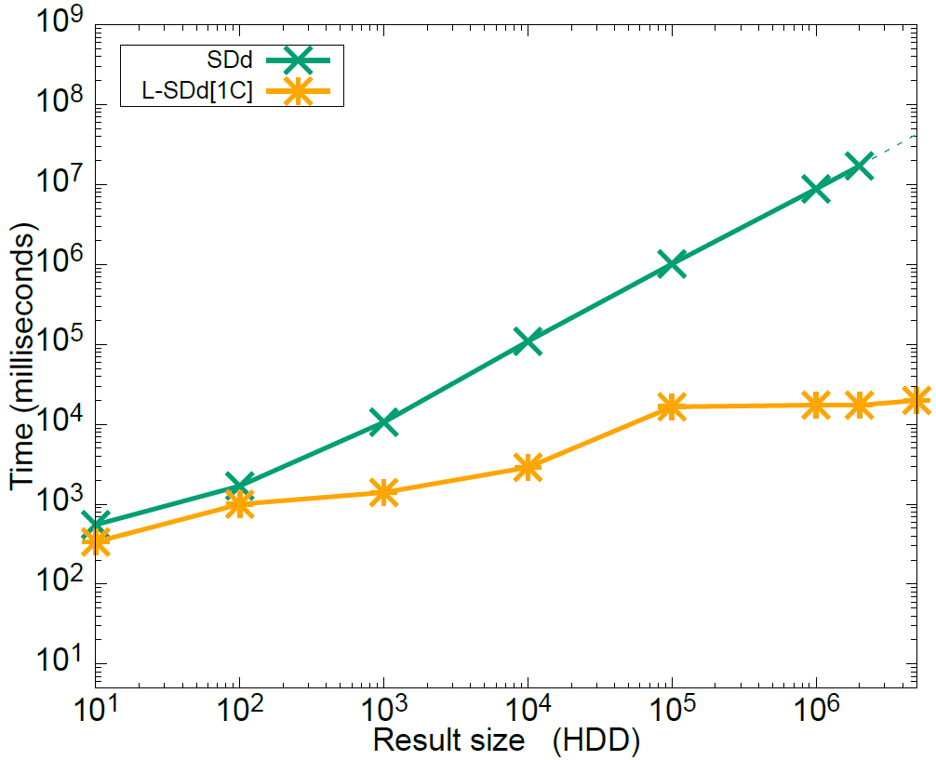
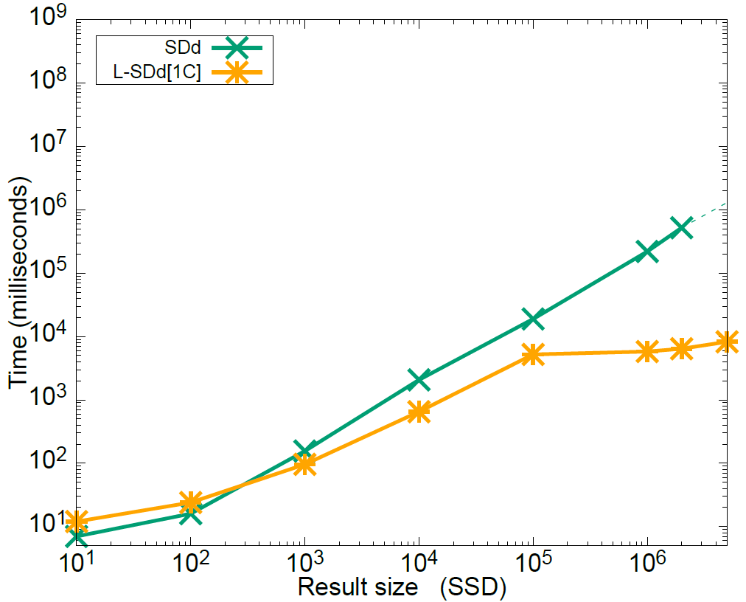
L-SDd Experiments : Search time vs Variable result size
1017s
19s
16s
63X
5s
3.8X
Setup
|DB| = 2²³, |block| = 32B
HDD(left) & SSD(right)
Notes:
Today I wanna show you the results for search time,
For update related results please see our paper
This figure is for search time vs var result sizes with DB of 8M records
The green line here is for SDd
As you see the yellow line for LSDd with 1C performs almost 63 times better on HDD for result size of 10^5
Speedup is only 3.8 times on SSD
As 1C is not ideal for SSDs but we did experiments with other schemes as well
L-SDd[1C] scheme perform better for big datasets
All bins are read for result size > 10⁵ , hence constant search time
Search
14a → HDD
14e → SSD
12d → RAM
Update
HDD → 11a
RAM → 11b

Slide 49
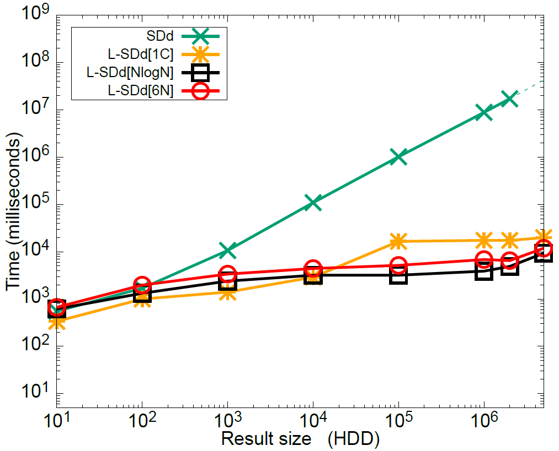
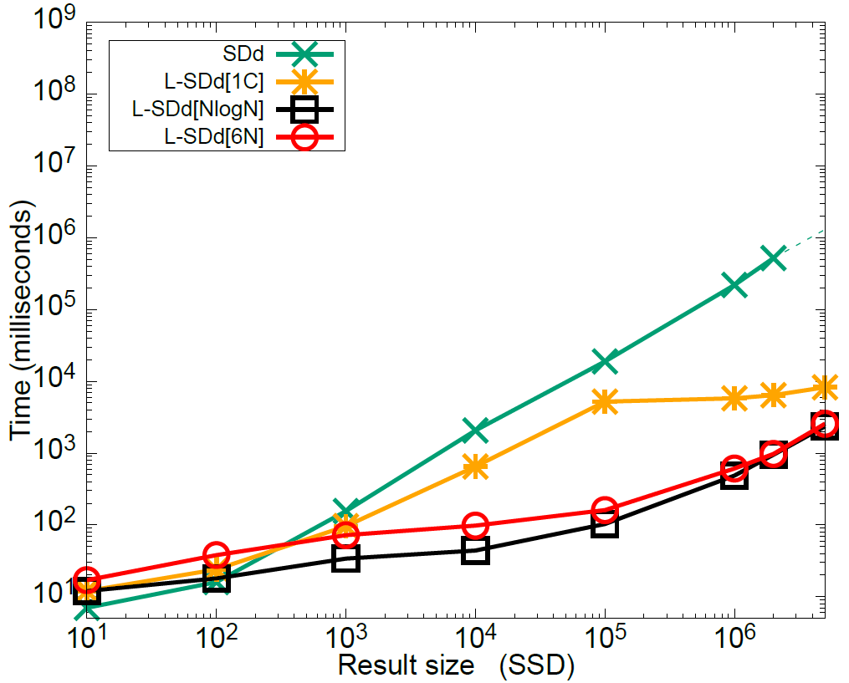
L-SDd Experiments : Search time vs Variable result size
1017s
19s
3s
0.1s
340X
190X
Setup
|DB| = 2²³, |block| = 32B
HDD(left) & SSD(right)
Notes:
Here you see L-SDd with NlogN scheme, performs 190 times better on SSD and 340 times better on HDD than original SDd

Slide 50
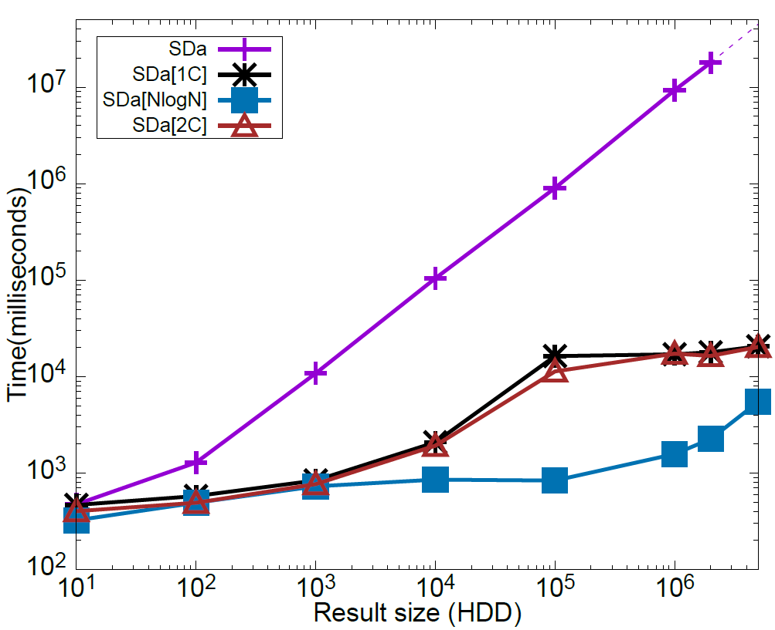
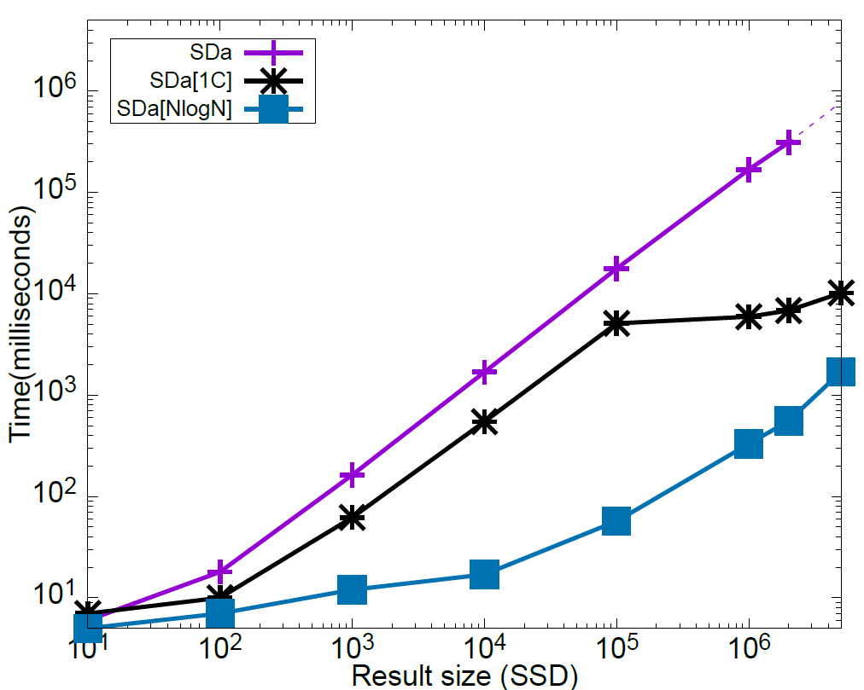
SDa Experiments : Search time vs Variable result size
903s
17s
0.8s
0.05s
1128X
310X
Setup
|DB| = 2²³, |block| = 32B
HDD(left) & SSD(right)
Notes:
Results
With the same setup, Sda with NlogN, performs more than 1000 times better on HDD and
More than 300 times better in SSD compared to original non-IO efficient SDa
Speedup in Sda is three times more dues to lesser indexes that LSDd

Slide 51
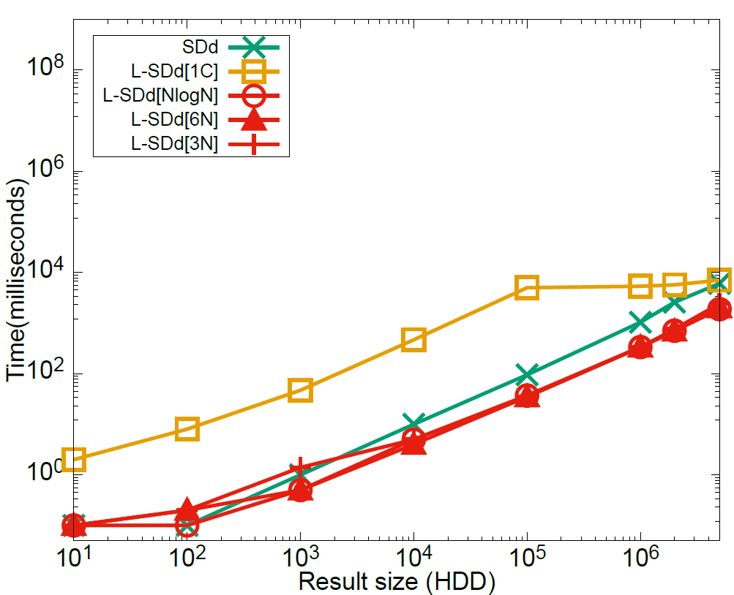
L-SDd Experiments : Search time vs Variable result size
100% caching
0.09s
0.037s
2.5X
Setup
Search time vs Result size in RAM
|DB| = 2²³, |block| = 32B
Notes:
Even with entire DB in memory LSDd with NlogN gains 2.5 times speedup than SDd
Results
SDd, L-SDd[1C] and L-SDd[NlogN] improve 8X, 2.4X & 2x resp.
With 75% of caching L-SDd[1C] and L-SDd[NlogN] are up to 191X and 641X faster

Slide 52
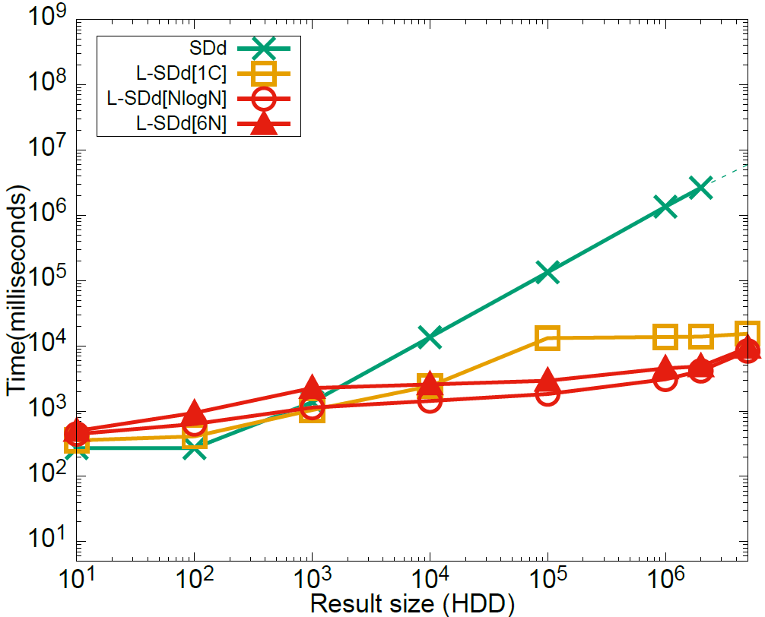
L-SDd Experiments : Search time (Variable caching)
134s
75% caching
100% caching
75% caching
0.09s
10X
13s
1.8s
0.037s
75X
2.5X
Setup
Search time vs Result size + Caching
|DB| = 2²³, |block| = 32B
75% cached on HDD(left) & RAM (right)
Notes:
Even with 75% caching Io efficienct schemes perform better
Only when 100% cache SDd performs better than 1C, but even then NlogN is better than it
Results
SDd, L-SDd[1C] and L-SDd[NlogN] improve 8X, 2.4X & 2x resp.
With 75% of caching L-SDd[1C] and L-SDd[NlogN] are up to 191X and 641X faster

Slide 53
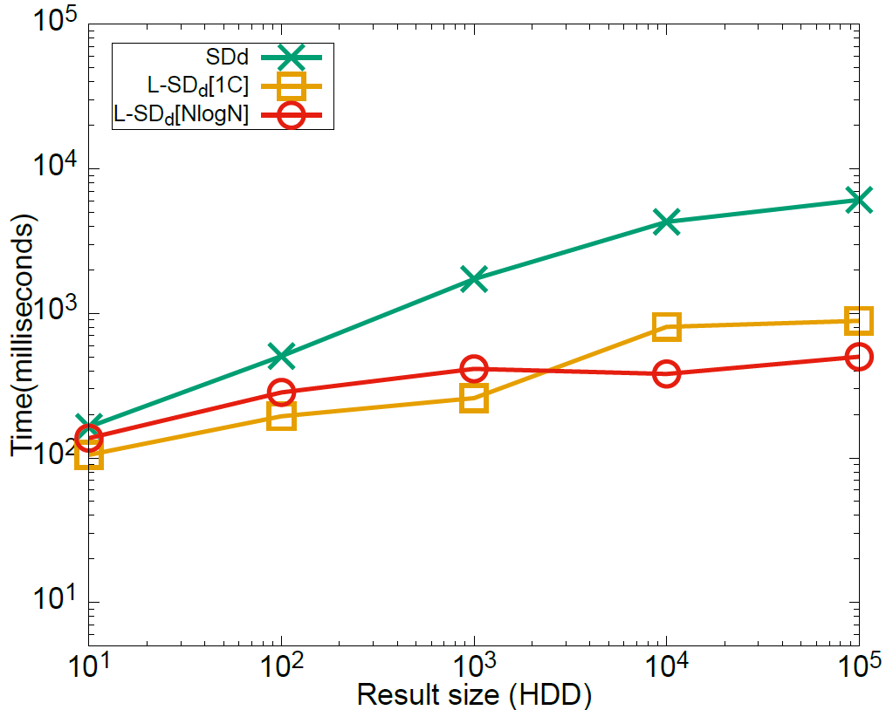
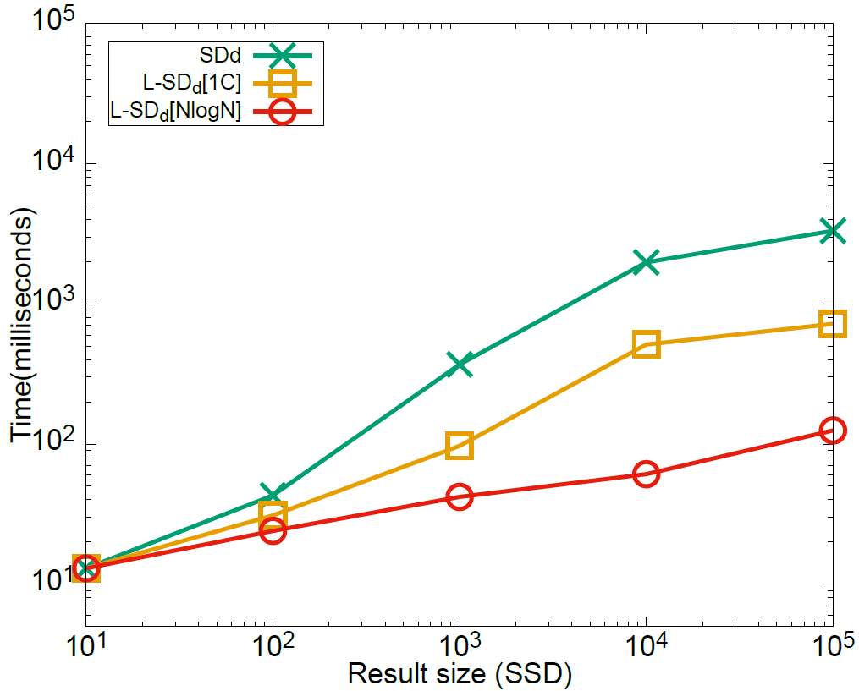
Experiments : Search time (Variable result size)
Setup
Search time vs Result size
|DB| = 2²⁰ ,|block| = 32B,
200 users in HDD (left)
75 users in SSD (right)
Cache enabled
Notes:
we emulate a scenario of encrypted keyword search in emails multiple users (200 for HDD and 75 for SSD) each with her own independent dataset (of size 220). With cache enabled, we executed random queries among users. As the figure shows, due to the size of datasets being larger than the memory (encrypted indexes for HDD and SSD were 1.8TB and 675GB), we see a similar trend as Figures 8 (a, b).

Slide 54
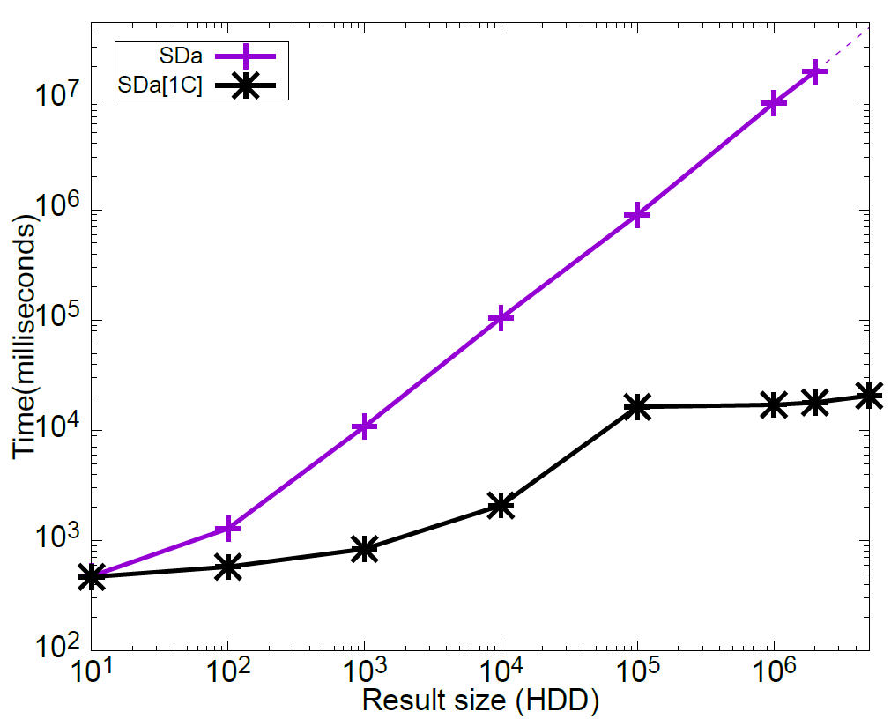
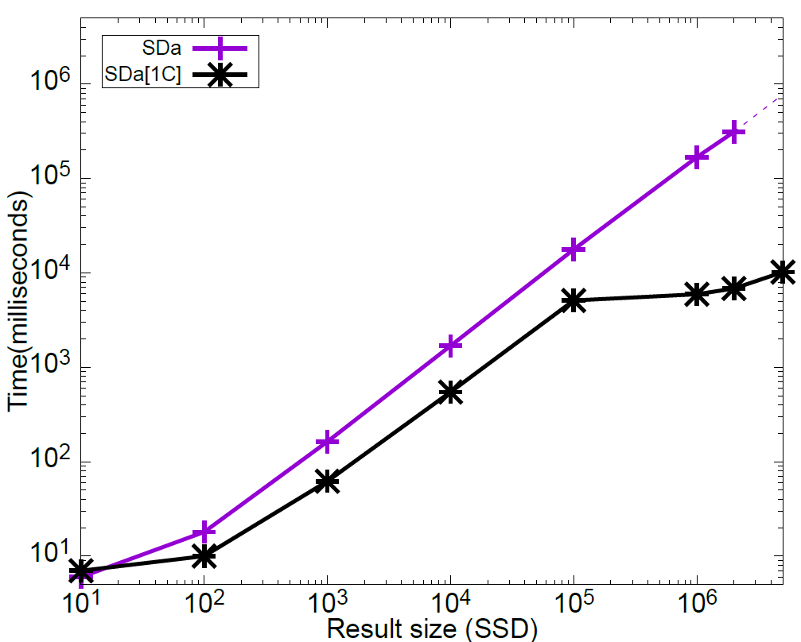
SDa Experiments : Search time (Variable result size)
Setup
Search time vs Result size
|DB| = 2²³ , |block| = 32B,
HDD (left) and SSD (right)
Results
SDa[1C] scheme performs better
All bins are read for result size > 10⁵ , hence constant search time
Notes:
remove

Slide 55
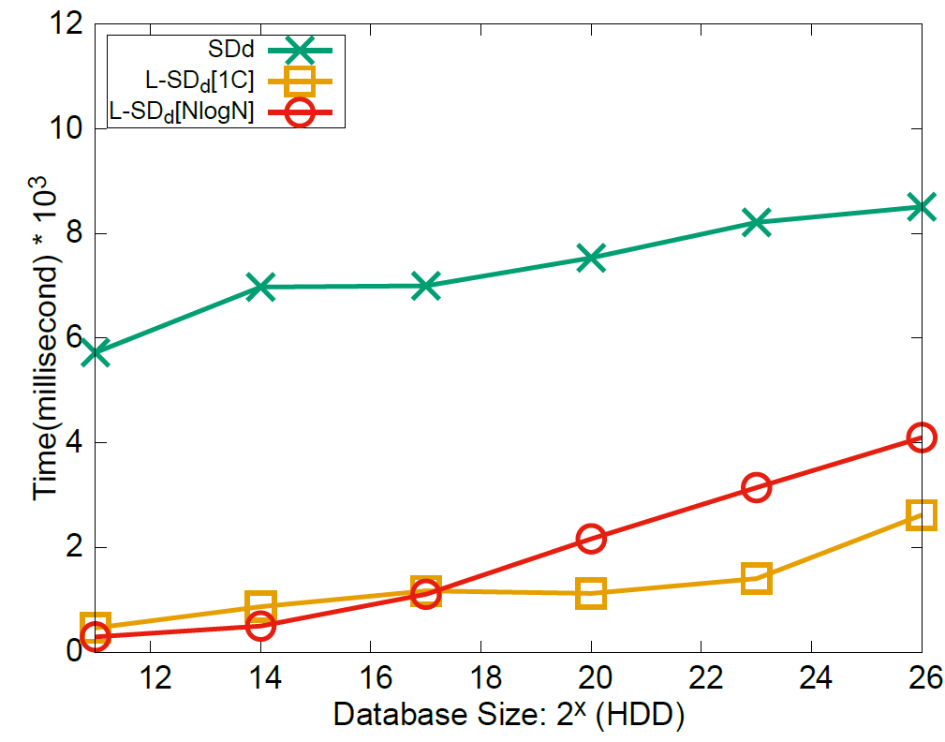
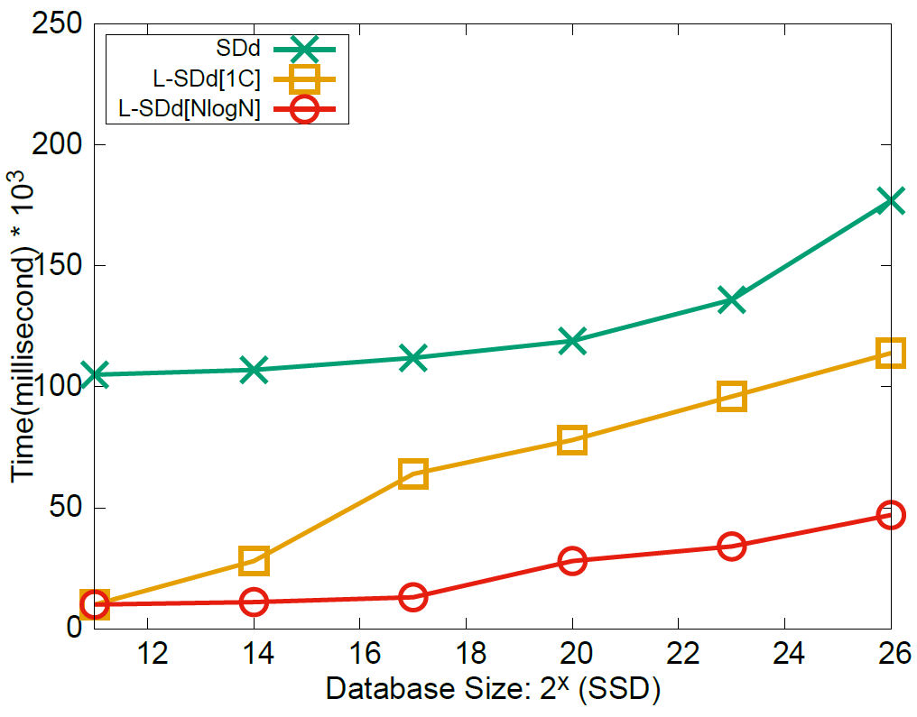
L-SDd Experiments : Search time (Variable DB size)
Setup
Search time vs DB size
Result size = 1K ,|block| = 32B,
HDD (left) and SSD (right)
Results
L-SDd schemes perform better
L-SDd[1C] is faster than SDd by 2-58X
L-SDd[NlogN] is faster than SDd by 3-70X
Notes:
Remove - backup

Slide 56
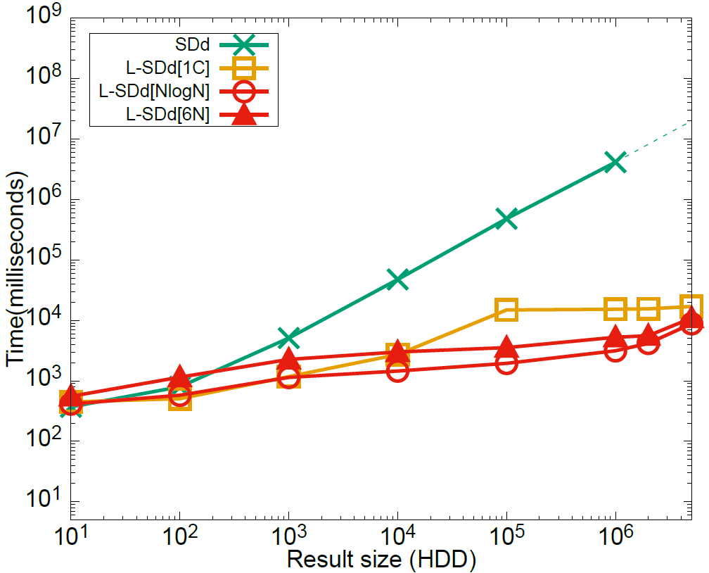
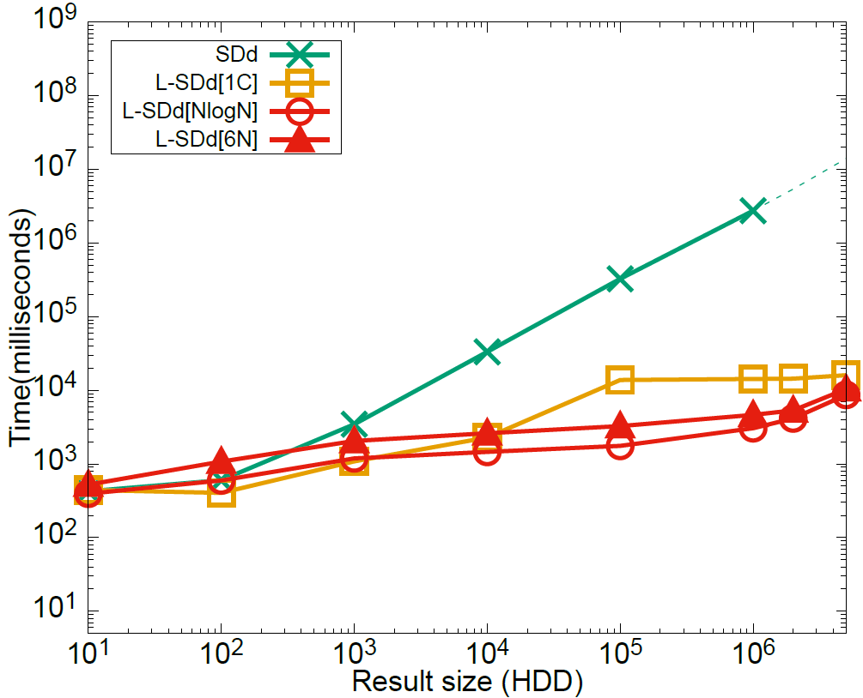
L-SDd Experiments : Search time (Variable caching)
25% caching
50% caching
Results
SDd, L-SDd[1C] and L-SDd[NlogN] improve 8X, 2.4X & 2x resp.
Setup
Search time vs Result size + Caching
|DB| = 2²³ , |block| = 32B
Notes:
Variable caching

Slide 57
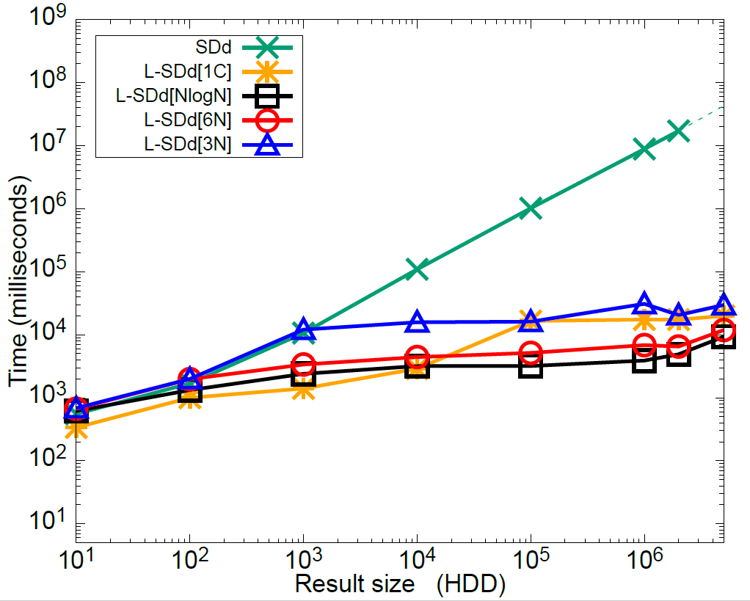
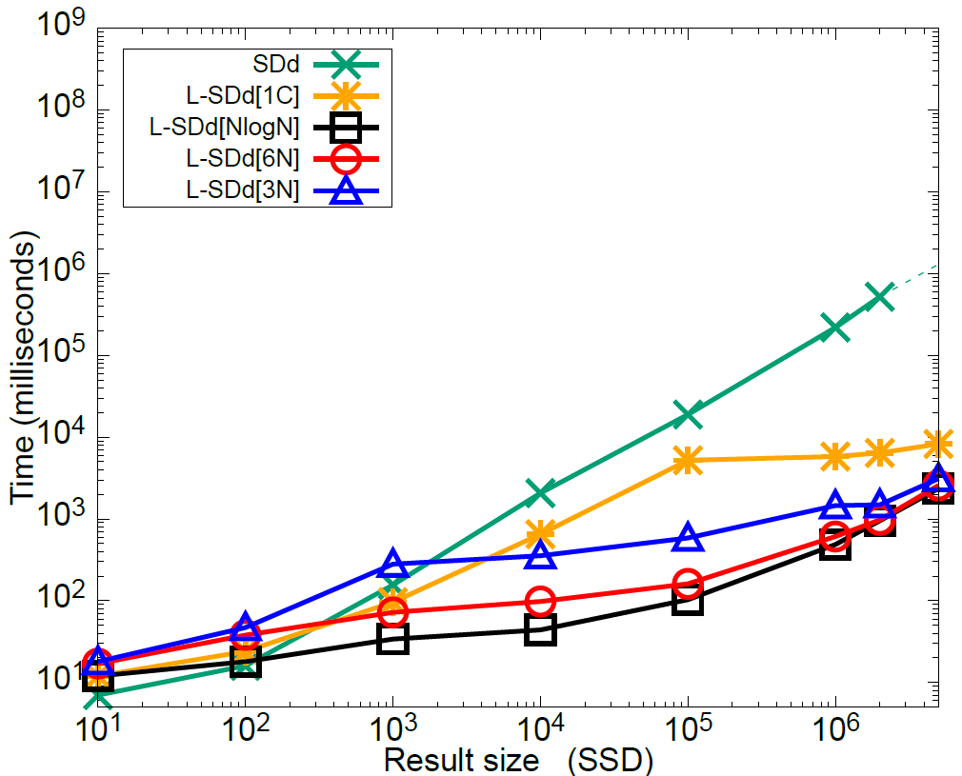
L-SDd Experiments : Search time (Variable result size)
Setup
Search time vs Result size
|DB| = 2²³ , |block| = 32B,
HDD (left) and SSD (right)
Results
L-SDd[1C] scheme perform better for big datasets
L-SDd[NlogN] performs best overall
For result size = 10⁵ L-SDd[1C], L-SDd[NlogN], and SDd take 16.5s, 3s, and 1001s respectively on HDD
Notes:
Overall NlogN performs better

Slide 58
Storage size for the Database
Scheme | Size(GB) for |DB| = 2²³ | Size(GB) for |DB| = 2²⁶
L-SDd[NlogN] | 49 | 436
L-SDd[1C] | 7.5 | 60
SDd | 5 | 40

Slide 59
Experiments
Implemented in C++
OpenSSL library used for cryptographic operations
Instantiated SDa[ ]/L-SDd[ ] with
One-Choice Allocation
Two-Choice Allocation
NlogN (and variations, e.g. 3N, 6N)
Compared with original SDa/SDd
Experiments were repeated 5 times and averaged
https://github.com/jgharehchamani/DSE-with-IO-Locality
Hardware setup:
8-core Intel Xeon E-2174G 3.8 GHz
128GB RAM
5TB HDD
1TB SSD
Search time
Variable size dataset with 2¹¹-2²⁶ records
Variable result-size between 5M-10M
Variable block-size of 32B- 512B
Two sets of experiments to show effect of cache
Different ratios of data in memory and cache
75-200 users with 2²⁰ records
search with cache enabled
Update time
Variable size dataset in RAM & HDD
L-SDd[1C] upto 2.5X faster than SDd for |DB| = 5M in RAM
L-SDd[1C] and L-SDd[NlogN] are 123X and 5X faster than SDd for |DB| = 5M, on HDD
Disk based experiments over WAN are similar to the single-machine case
Notes:
backup
Lets move on to experiments
We implemented everything in C++
We compare search and update time of our io-efficient schemes with Sda/SDd
Today I wanna show you the experiments for search time,
For updates please see our paper

Slide 60
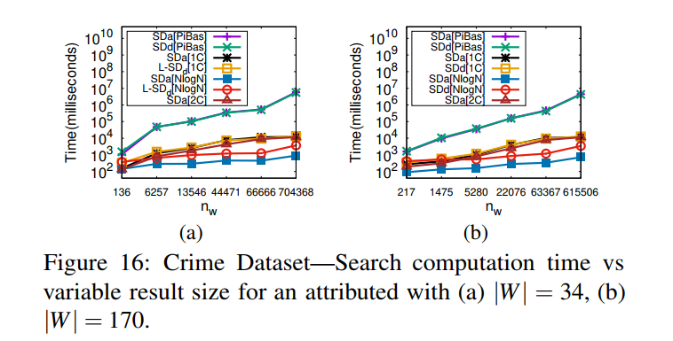
Search computaion time
|DB| = 6M
Chicago crime dataset since 2001

Slide 61
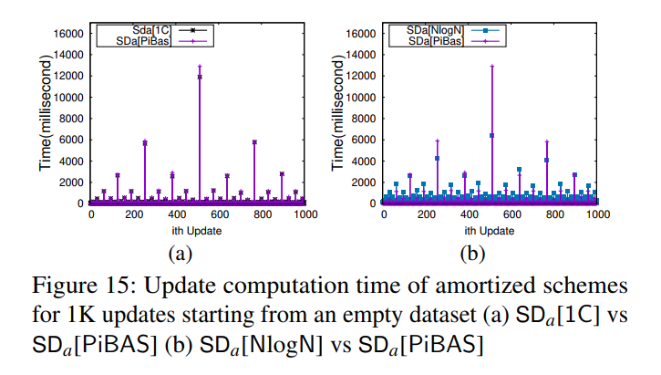

Slide 62
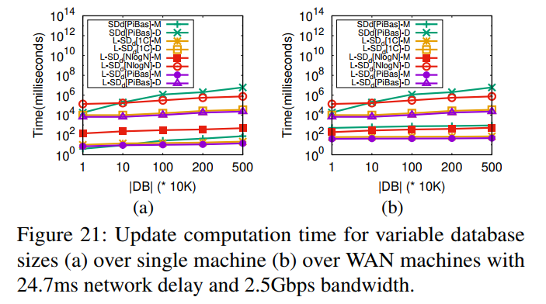
Update computation time
For variable DB sizes
(a) over single machine
(b) over WAN
24.7ms network delay
2.5Gbps bandwidth

